Slide 1
Chapter 2: Operating-System Structures

Slide 2
Objectives
To describe the services an operating system provides to users, processes, and other systems
To discuss the various ways of structuring an operating system
To explain how operating systems are booted

Slide 3
2.1 Operating System Services
Operating systems provide an environment for the execution of programs.
Operating systems provides certain services to:
  Programs
  Users of those programs
Basically two types of services:
  Set of operating-system services provides functions that are helpful to the user:
  Set of operating-system functions for ensuring the efficient operation of the system itself via resource sharing

Slide 4
OS Services Helpful to the User
One of the many OS services is User interface.
User interface - Almost all operating systems have a user interface (UI). This interface can take several forms:
  Command-Line (CLI) -- uses text commands and a method for entering them (say, a keyboard for typing in commands in a specific format with specific options).
  Graphics User Interface (GUI) -- the interface is a window system with a pointing device to direct I\O, choose from menus, and make selections and a keyboard to enter text..
  Batch Interface -- commands and directives to control those commands are entered into files, and those files are executed
  Some systems provide two or all three of these variations.

Slide 5
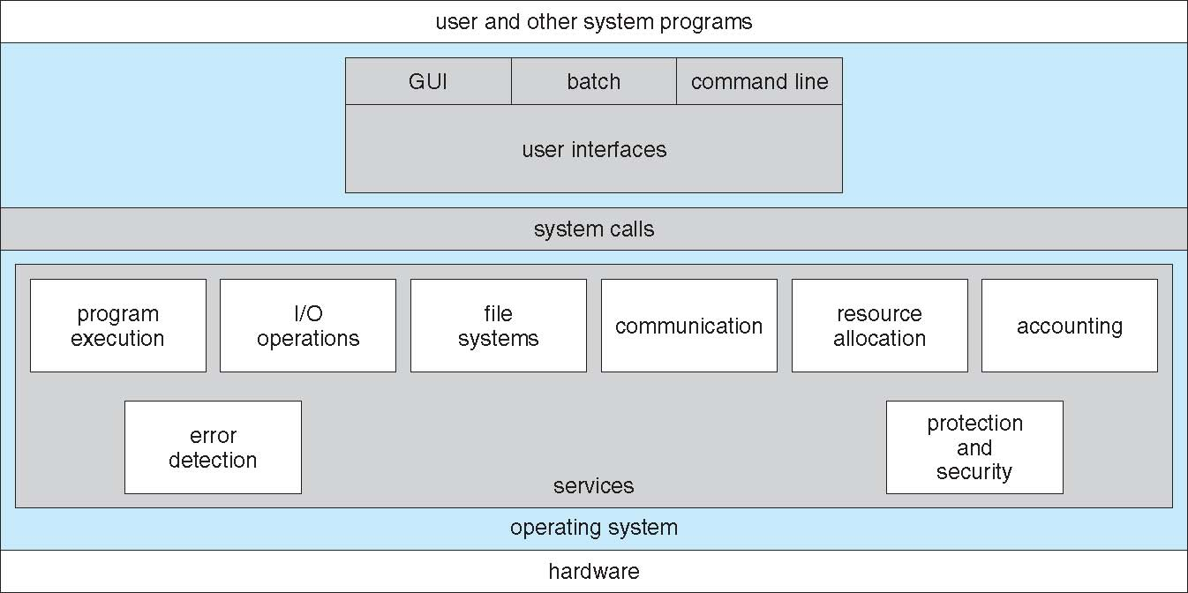
A View of Operating System Services
Figure 2.1

Slide 6
2.2.1 Command Interpreters (CLI)
CLI allows users to directly enter commands to be performed by the operating system.
Some operating systems include the command interpreter in the kernel.
Some operating systems, such as Windows and UNIX, treat the command interpreter as a special program that is running when a job is initiated or when a user first logs on.
On systems with multiple command interpreters to choose from, the interpreters are known as shells.
The main function of the command interpreter is to get and execute the next user-specified command.
Sometimes commands built-in, sometimes just names of programs
  If the latter, adding new features doesn’t require shell modification

Slide 7
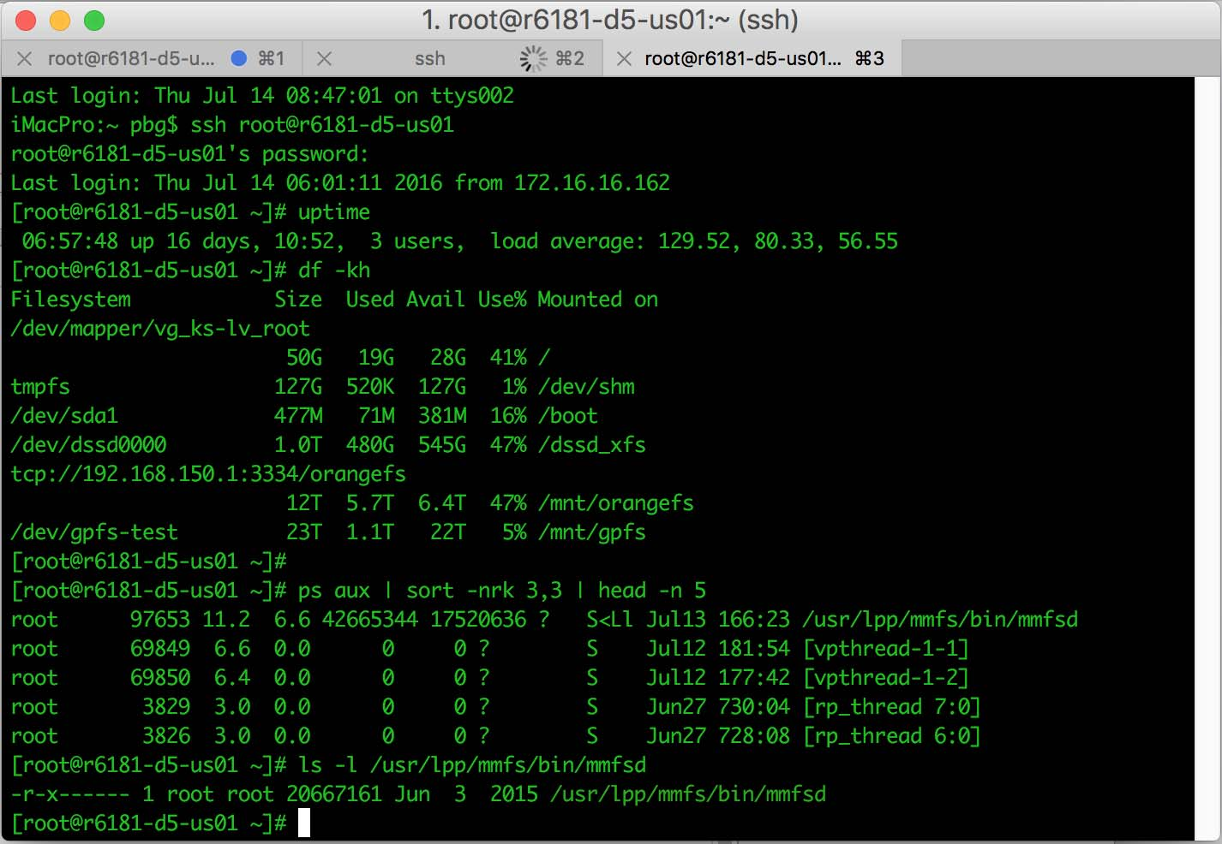
The Bourne shell command interpreter in Solaris

Slide 8
2.2.2 Graphical User Interfaces (GUI)
User-friendly desktop metaphor interface
  Usually mouse, keyboard, and monitor
  Icons represent files, programs, actions, etc
  Various mouse buttons over objects in the interface cause various actions (provide information, options, execute function, open directory (known as a folder)
  Invented at Xerox PARC
Many systems now include both CLI and GUI interfaces
  Microsoft Windows is GUI with CLI “command” shell
  Apple Mac OS X is “Aqua” GUI interface with UNIX kernel underneath and shells available
  Unix and Linux have CLI with optional GUI interfaces (CDE, KDE, GNOME)

Slide 9
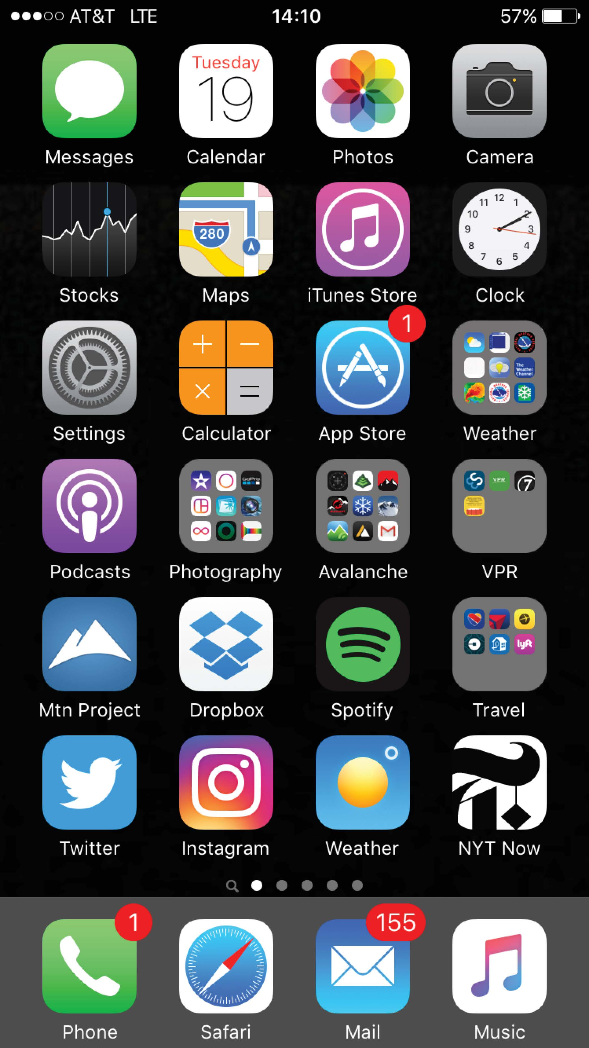
Touchscreen Interfaces
Touchscreen devices require new interfaces
  Mouse not possible or not desired
  Actions and selection based on gestures
  Virtual keyboard for text entry
Voice commands.

Slide 10
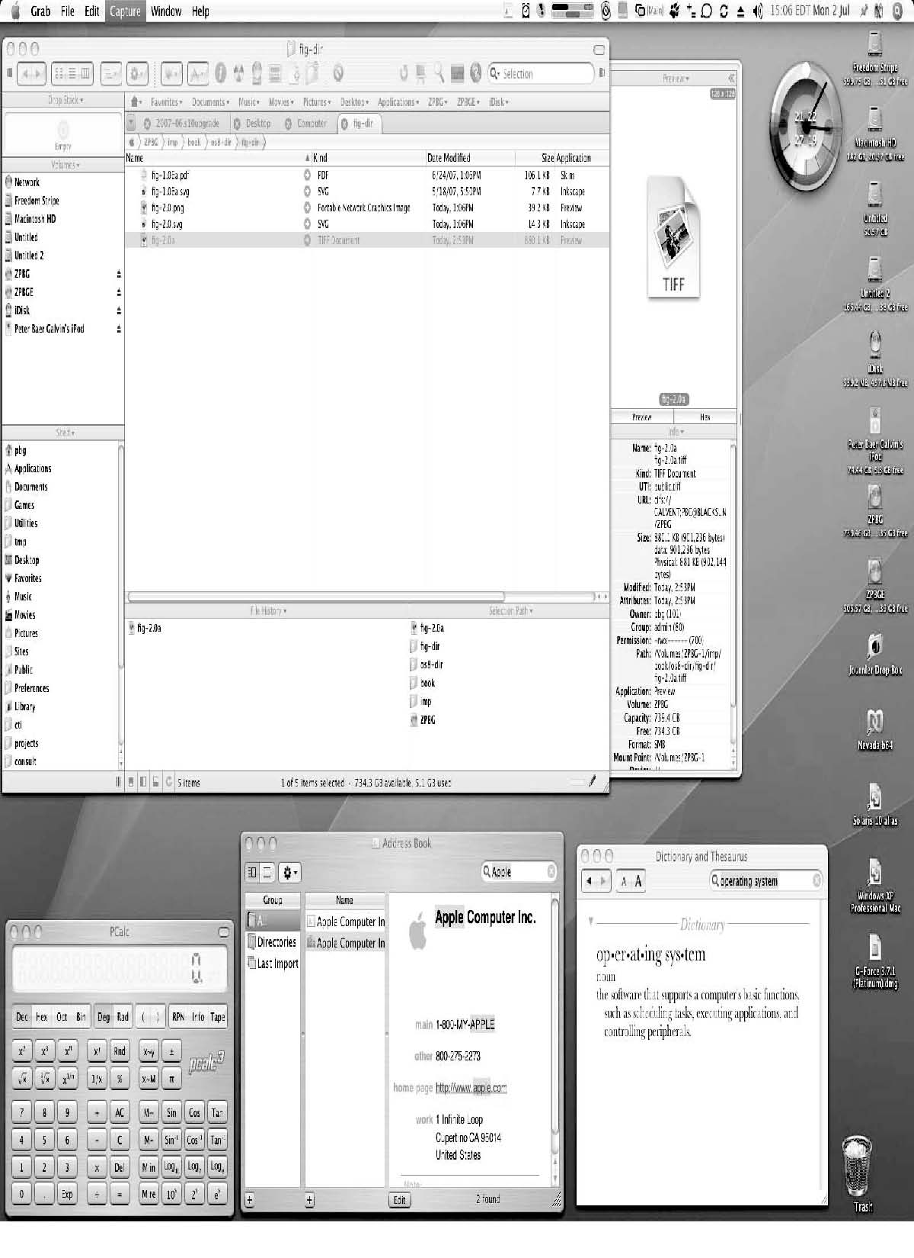
The Mac OS X GUI
Figure 2.4

Slide 11
2.3 System Calls
Programming interface to the services provided by the OS
Typically written in a high-level language (C or C++)
Mostly accessed by programs via a high-level Application Programming Interface (API) rather than direct system call
Three most common APIs are:
  Win32 API for Windows,
  POSIX API for POSIX-based systems (including virtually all versions of UNIX, Linux, and Mac OS X),
  Java API for the Java virtual machine (JVM)
Note that the system-call names used throughout this text are generic

Slide 12
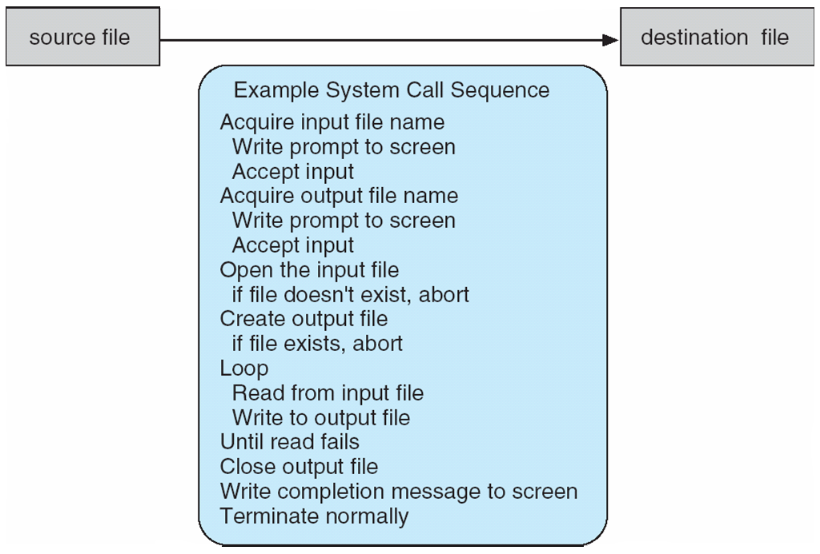
Example of System Calls
System call sequence to copy the contents of one file to another file
Figure 2.5

Slide 13
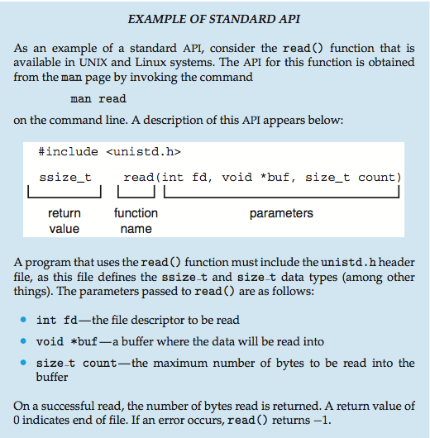
Example of Standard API

Slide 14
2.4 Types of System Calls
System calls can be grouped roughly into six major categories:
  Process control,
  File manipulation,
  Device manipulation,
  Information maintenance,
  Communications,
  Protection.

Slide 15
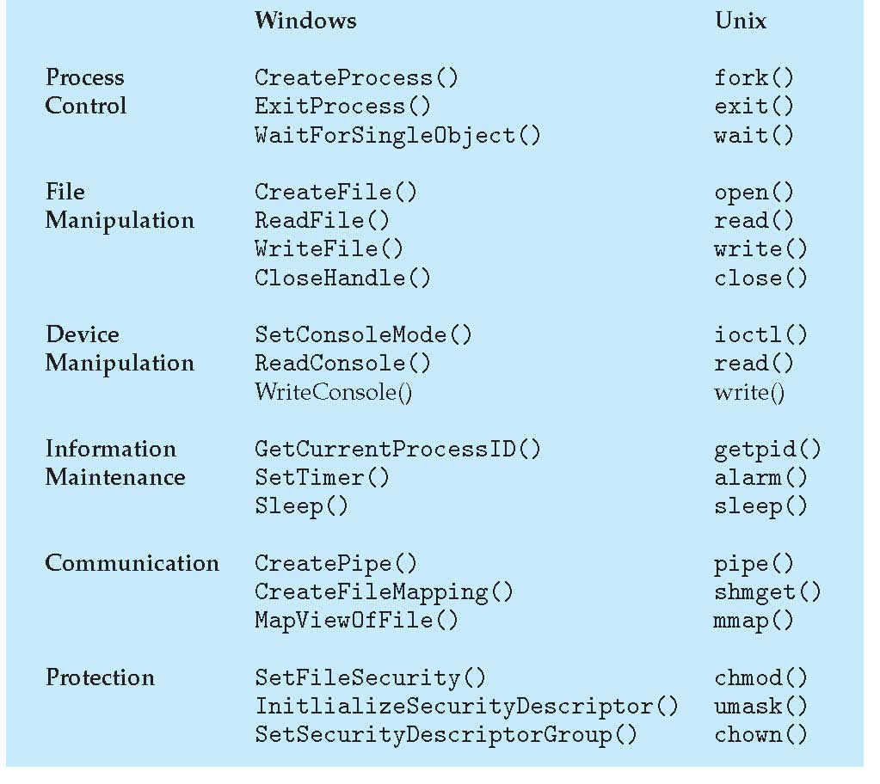
Examples of Windows and Unix System Calls

Slide 16
2.5 System Programs
System programs provide a convenient environment for program development and execution.
Some of them are simply user interfaces to system calls. Others are considerably more complex.
They can be divided into:
  File manipulation
  Status information sometimes stored in a File modification
  Programming language support
  Program loading and execution
  Communications
  Background services
  Application programs
Most users’ view of the operation system is defined by system programs, not the actual system calls

Slide 17
2.7 Operating System Structure
Various ways to structure an operating system:
  Monolithic structure
    Simple structure – MS-DOS
    More complex – UNIX
    More complex – Linux
  Layered – An abstraction
  Microkernel - Mach

Slide 18
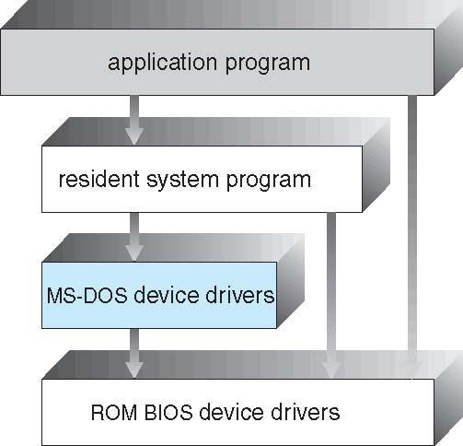
2.7.1 Simple Structure: MS-DOS
MS-DOS – written to provide the most functionality in the least amount of space
MS-DOS was limited by hardware funcionality.
  Not divided into modules
  Although MS-DOS has some structure, its interfaces and levels of functionality are not well separated

Slide 19
2.7.1 More Complex: UNIX
UNIX – the original UNIX operating system had limited structuring and was limited by hardware functionality.
The UNIX OS consists of two separable parts
  Systems programs
  The kernel
    Consists of everything below the system-call interface and above the physical hardware
    Provides the file system, CPU scheduling, memory management, and other operating-system functions; a large number of functions for one level

Slide 20
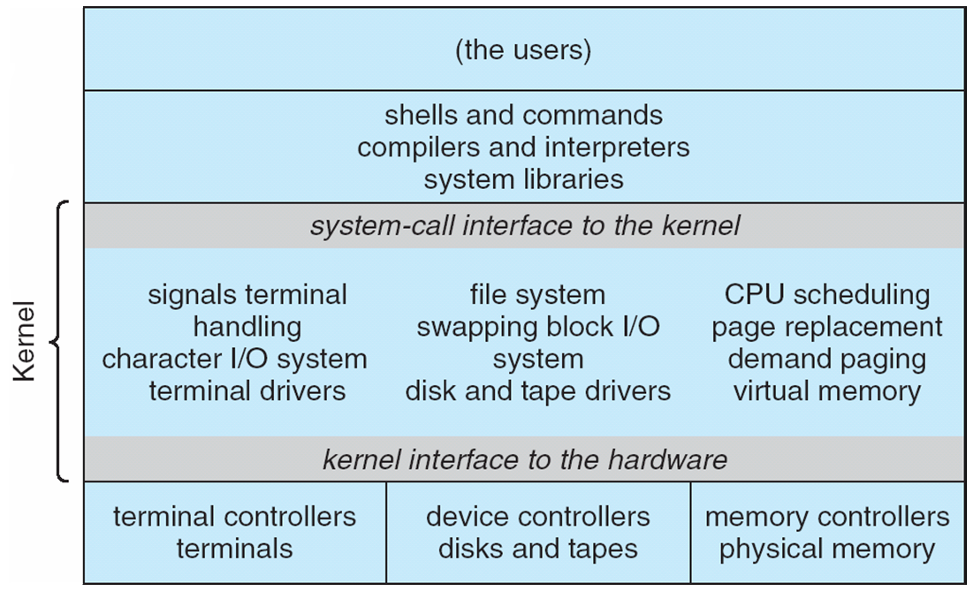
Traditional UNIX System Structure
Figure 2.12

Slide 21
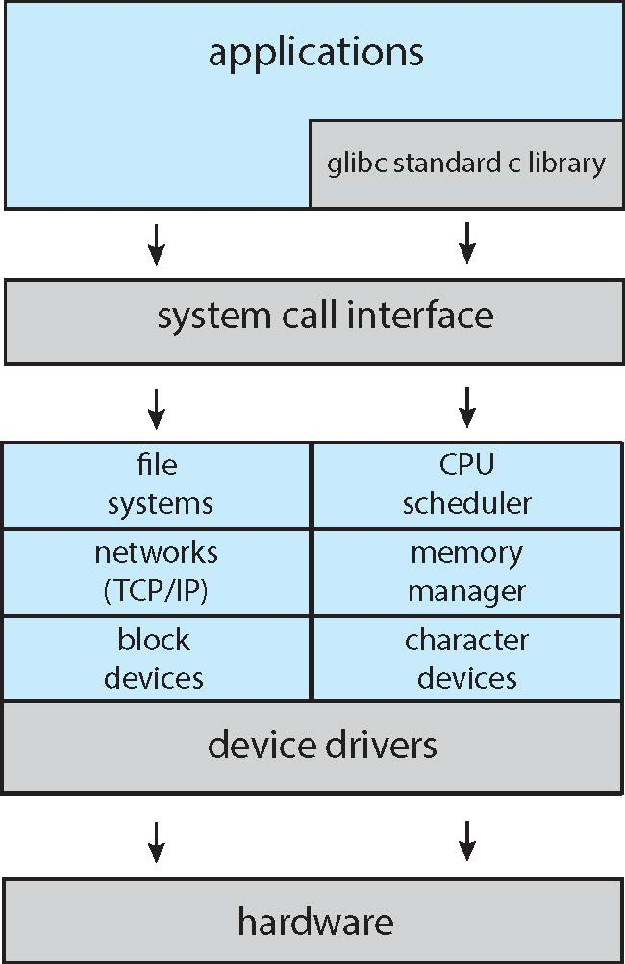
Linux System Structure

Slide 22
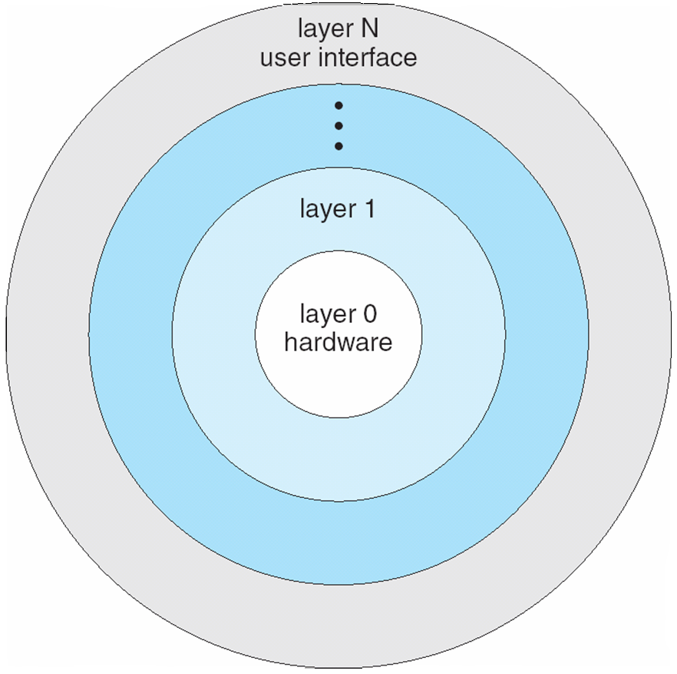
2.7.2 Layered Approach
A system can be made modular in many ways. One method is the layered approach, in which the operating system is broken into a number of layers (levels). The bottom layer (layer 0) is the hardware; the highest (layer N) is the user interface.
Figure 2.13

Slide 23
2.7.3 Microkernel System Structure
Moves as much from the kernel into user space
Mach example of microkernel
  Mac OS X kernel (Darwin) partly based on Mach
Communication takes place between user modules using message passing
Benefits:
  Easier to extend a microkernel
  Easier to port the operating system to new architectures
  More reliable (less code is running in kernel mode)
  More secure
Detriments:
  Performance overhead of user space to kernel space communication

Slide 24
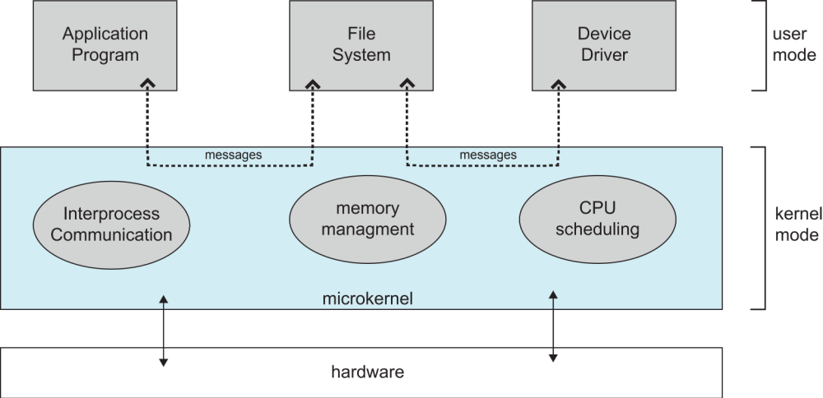
Microkernel System Structure
Figure 2.14

Slide 25
2.7.4 Modules
Many modern operating systems implement loadable kernel modules
  Uses object-oriented approach
  Each core component is separate
  Each talks to the others over known interfaces
  Each is loadable as needed within the kernel
Overall, similar to layers but with more flexible
  Linux, Solaris, etc

Slide 26
2.7.5 Hybrid Systems
In practice, very few operating systems adopt a single, strictly defined structure.
Instead, they combine different structures, resulting in hybrid systems that address performance, security, and usability issues.
  For example, Linux is monolithic, because having the operating system in a single address space provides very efficient performance. However, Linux are also modular, so that new functionality can be dynamically added to the kernel.
Examples of the structure of hybrid systems:
  Apple Mac operating system (laptop)
  iOS (mobile operating systems)
  Android (mobile operating systems)

Slide 27
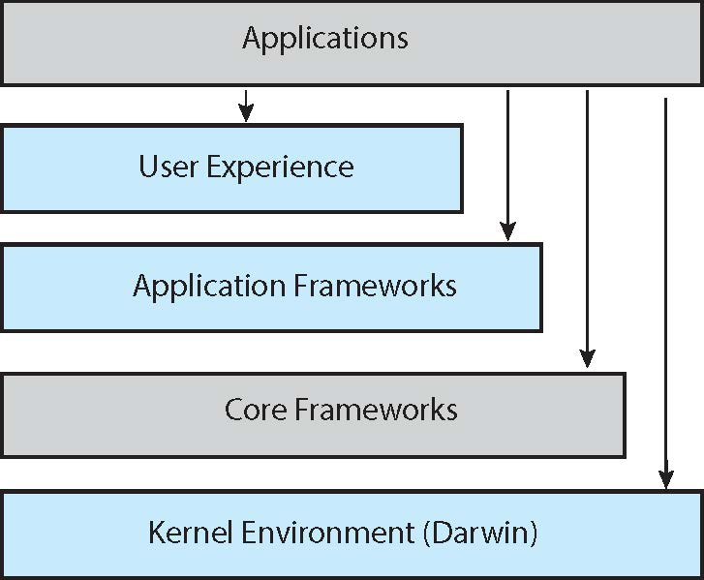
Architecture of Mac OS X and iOS

Slide 28
Android
Developed by Open Handset Alliance (mostly Google)
  Open Source
Similar stack to iOS
Based on Linux kernel but modified
  Provides process, memory, device-driver management
  Adds power management
Runtime environment includes core set of libraries and Dalvik virtual machine
  Apps developed in Java plus Android API
    Java class files compiled to Java bytecode then translated to executable than runs in Dalvik VM
Libraries include frameworks for web browser (webkit), database (SQLite), multimedia, smaller libc

Slide 29
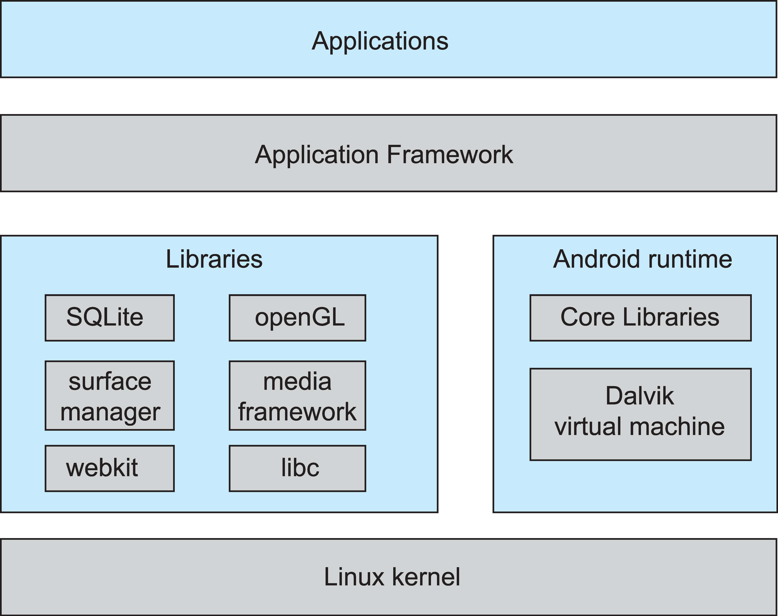
Android Architecture

Slide 30
2.10 System Boot
When power initialized on system, execution starts at a fixed memory location
  Firmware ROM used to hold initial boot code
Operating system must be made available to hardware so hardware can start it
  Small piece of code – bootstrap loader, stored in ROM or EEPROM locates the kernel, loads it into memory, and starts it
  Sometimes two-step process where boot block at fixed location loaded by ROM code, which loads bootstrap loader from disk
Common bootstrap loader, GRUB, allows selection of kernel from multiple disks, versions, kernel options
Kernel loads and system is then running

Slide 31
EXERCISE
From Silberchatz, Operating System Concepts Chapter 2 Exercises
Odd number Matric card – 2.1, 2.11, 2.13
Even number Matric card – 2.6, 2.10, 2.12
Due date: Submit to e-learning 5 days after you receive the textbook.

Slide 32
End of Chapter 2

